Slide 1





JSON
Exporting and Importing Data from JSON format
Databases
Frameworks
SoftUni Team
Technical Trainers
Software University
http://softuni.bg

Slide 2

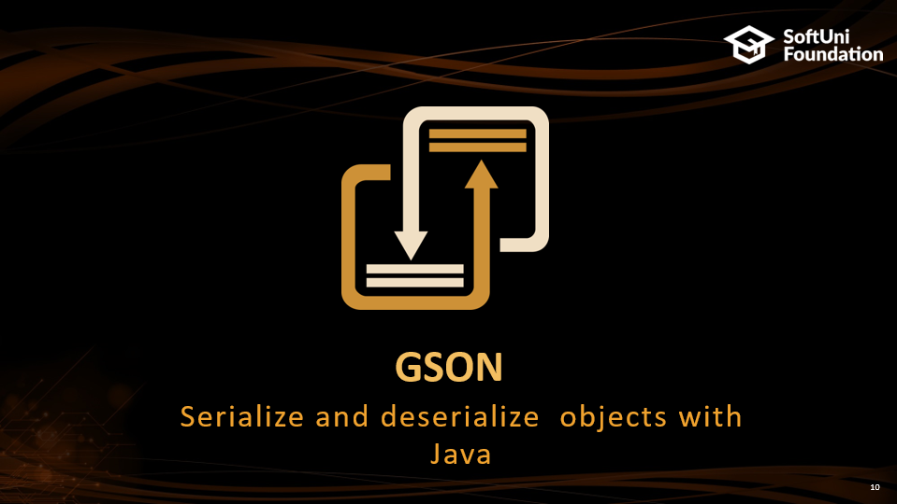
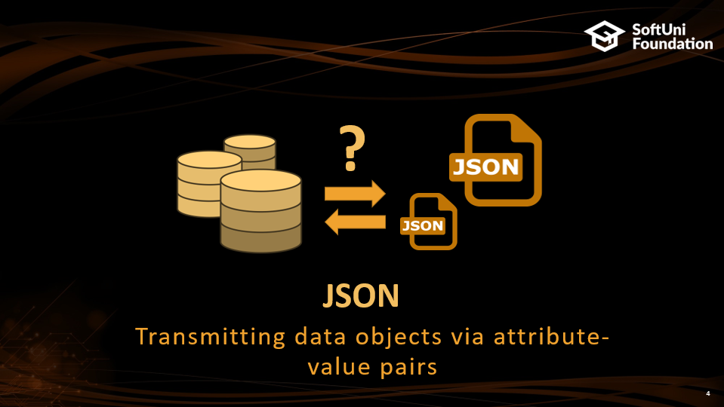

Table of Contents

Slide 3
Questions
sli.do #JavaDB

Slide 4
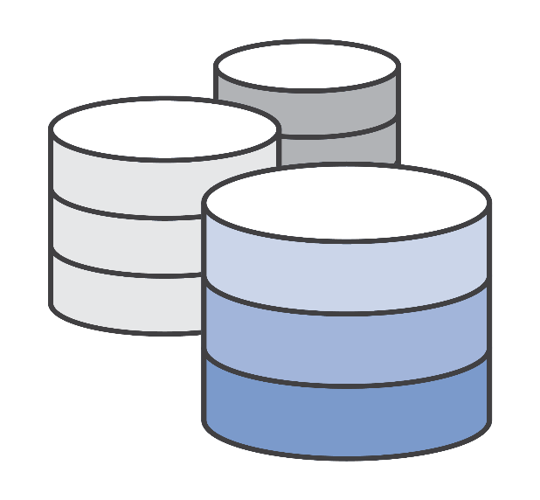
?
JSON
Transmitting data objects via attribute-value pairs

Slide 5
JSON
JavaScript Object Notation
Human-readable format to transmit data objects consisting of attribute–value pairs and arrays
Subset of JavaScript syntax
Supports several data types:
Number, String, Boolean, Array, Object, null

Slide 6
JSON Example
student.json
{
"firstName": "Daniel",
"lastName": "Sempre",
"age": 24,
"courses": [
{
"name": "Java DB",
},
{
"name": "HTML",
},
]
}
person.json
Value
{
"firstName": "Daniel",
"lastName": "Sempre",
"age": 24,
"isMarried": true
}
Array type value
Key

Slide 7
JSON Function
JavaScript
Java, PHP, C#
Client
JSON
Server
person.js
person.json
PersonController.java
CarController.java
car.js
car.json

Slide 8
JSON Structure
Data is represented in name/value pairs
Curly braces hold objects
Square brackets hold arrays
Object holder
person.json
Key
Value
{
"firstName": "Daniel",
"lastName": "Sempre",
"age": 24,
"isMarried": true
}
Comma separated

Slide 9
JSON Structure
person.json
Key
{
"firstName": "John",
"lastName": "Snow",
"address": {
"country": "Spain",
"city": "Barcelona",
"street": "Barcelona"
},
"phoneNumbers": [
{
"number": "1e341341"
},
{
"number": "542152"
}
]
}
Value
Nested object
Object holder
Array holder
Nested array of objects

Slide 10

GSON
Serialize and deserialize objects with Java

Slide 11
GSON
Provides easy to use mechanisms to convert Java to JSON and vice-versa
Originally developed by Google
Generate compact and readability JSON output
pom.xml
<dependency>
<groupId>com.google.code.gson</groupId>
<artifactId>gson</artifactId>
</dependency>

Slide 12
GSON Initialization
Gson objects are responsible for the JSON manipulations
GsonBuilder creates an instance of GSON
excludeFieldsWithoutExposeAnnotation() – excludes fields without @Expose annotation
setPrettyPrinting() – aligns and justifies the created JSON format
create() – creates an instance of Gson
JsonParser.java
Gson gson = new GsonBuilder()
.excludeFieldsWithoutExposeAnnotation()
.setPrettyPrinting()
.create();

Slide 13
Export Single Object to JSON
AddressJsonDto.java
public class AddressJsonDto implements Serializable {
@Expose
private String country;
@Expose
private String city;
@Expose
private String street;
}
The field will be imported/exported
JsonParser.java
AddressJsonDto addressJsonDto = new AddressJsonDto();
addressJsonDto.setCountry("Bulgaria");
addressJsonDto.setCity("Sofia");
addressJsonDto.setStreet("Mladost 4"); String content = this.gson.toJson(addressJsonDto);
Creates JSON

Slide 14
Export Single Object to JSON
JsonParser.java
AddressJsonDto addressJsonDto = new AddressJsonDto();
addressJsonDto.setCountry("Bulgaria");
addressJsonDto.setCity("Sofia");
addressJsonDto.setStreet("Mladost 4"); String content = this.gson.toJson(addressJsonDto);
address.json
{
"country": "Bulgaria",
"city": "Sofia",
"street": "Mladost 4"
}

Slide 15
Export Multiple Object to JSON
JsonParser.java
List<AddressJsonDto> addressJsonDtos = new ArrayList<>();
addressJsonDtos.add(addressJsonDtoBulgaria);
addressJsonDtos.add(addressJsonDtoSpain);
String content = this.gson.toJson(addressJsonDtos);
addresses.json
[
{
"country": "Bulgaria",
"city": "Sofia",
"street": "Mladost 4"
},
{
"country": "Spain",
"city": "Barcelona",
"street": "Las Ramblas"
}
]

Slide 16
Import Single Object to JSON
AddressJsonDto.java
public class AddressJsonDto implements Serializable {
@Expose
private String country;
@Expose
private String city;
@Expose
private String street;
}
The field will be imported/exported
JsonParser.java
AddressJsonDto addressJsonDto =
this.gson.fromJson(AddressJsonDto.class, "/files/input/json/address.json");

Slide 17
Import Single Object to JSON
AddressJsonDto.java
public class AddressJsonDto implements Serializable {
@Expose
private String country;
@Expose
private String city;
@Expose
private String street;
}
address.json
{
"country": "Bulgaria",
"city": "Sofia",
"street": "Mladost 4"
}

Slide 18
Import Multiple Object to JSON
JsonParser.java
AddressJsonDto[] addressJsonDtos =
this.gson.fromJson(AddressJsonDto[].class, "/files/input/json/addresses.json");
Object Array
addresses.json
[
{
"country": "Bulgaria",
"city": "Sofia",
"street": "Mladost 4"
},
{
"country": "Spain",
"city": "Barcelona",
"street": "Las Ramblas"
}
]

Slide 19

Summary
JSON is a very easy to use and understand format
GSON is a java library to operate with JSON files
Easy import and export

Slide 20







JSON
https://softuni.bg/courses/databases-advanced-hibernate

Slide 21
License
This course (slides, examples, demos, videos, homework, etc.) is licensed under the "Creative Commons Attribution-NonCommercial-ShareAlike 4.0 International" license
Attribution: this work may contain portions from
"Databases" course by Telerik Academy under CC-BY-NC-SA license

Slide 22





Free Trainings @ Software University
Software University Foundation – softuni.org
Software University – High-Quality Education, Profession and Job for Software Developers
softuni.bg
Software University @ Facebook
facebook.com/SoftwareUniversity
Software University Forums
forum.softuni.bg

